Slide 1

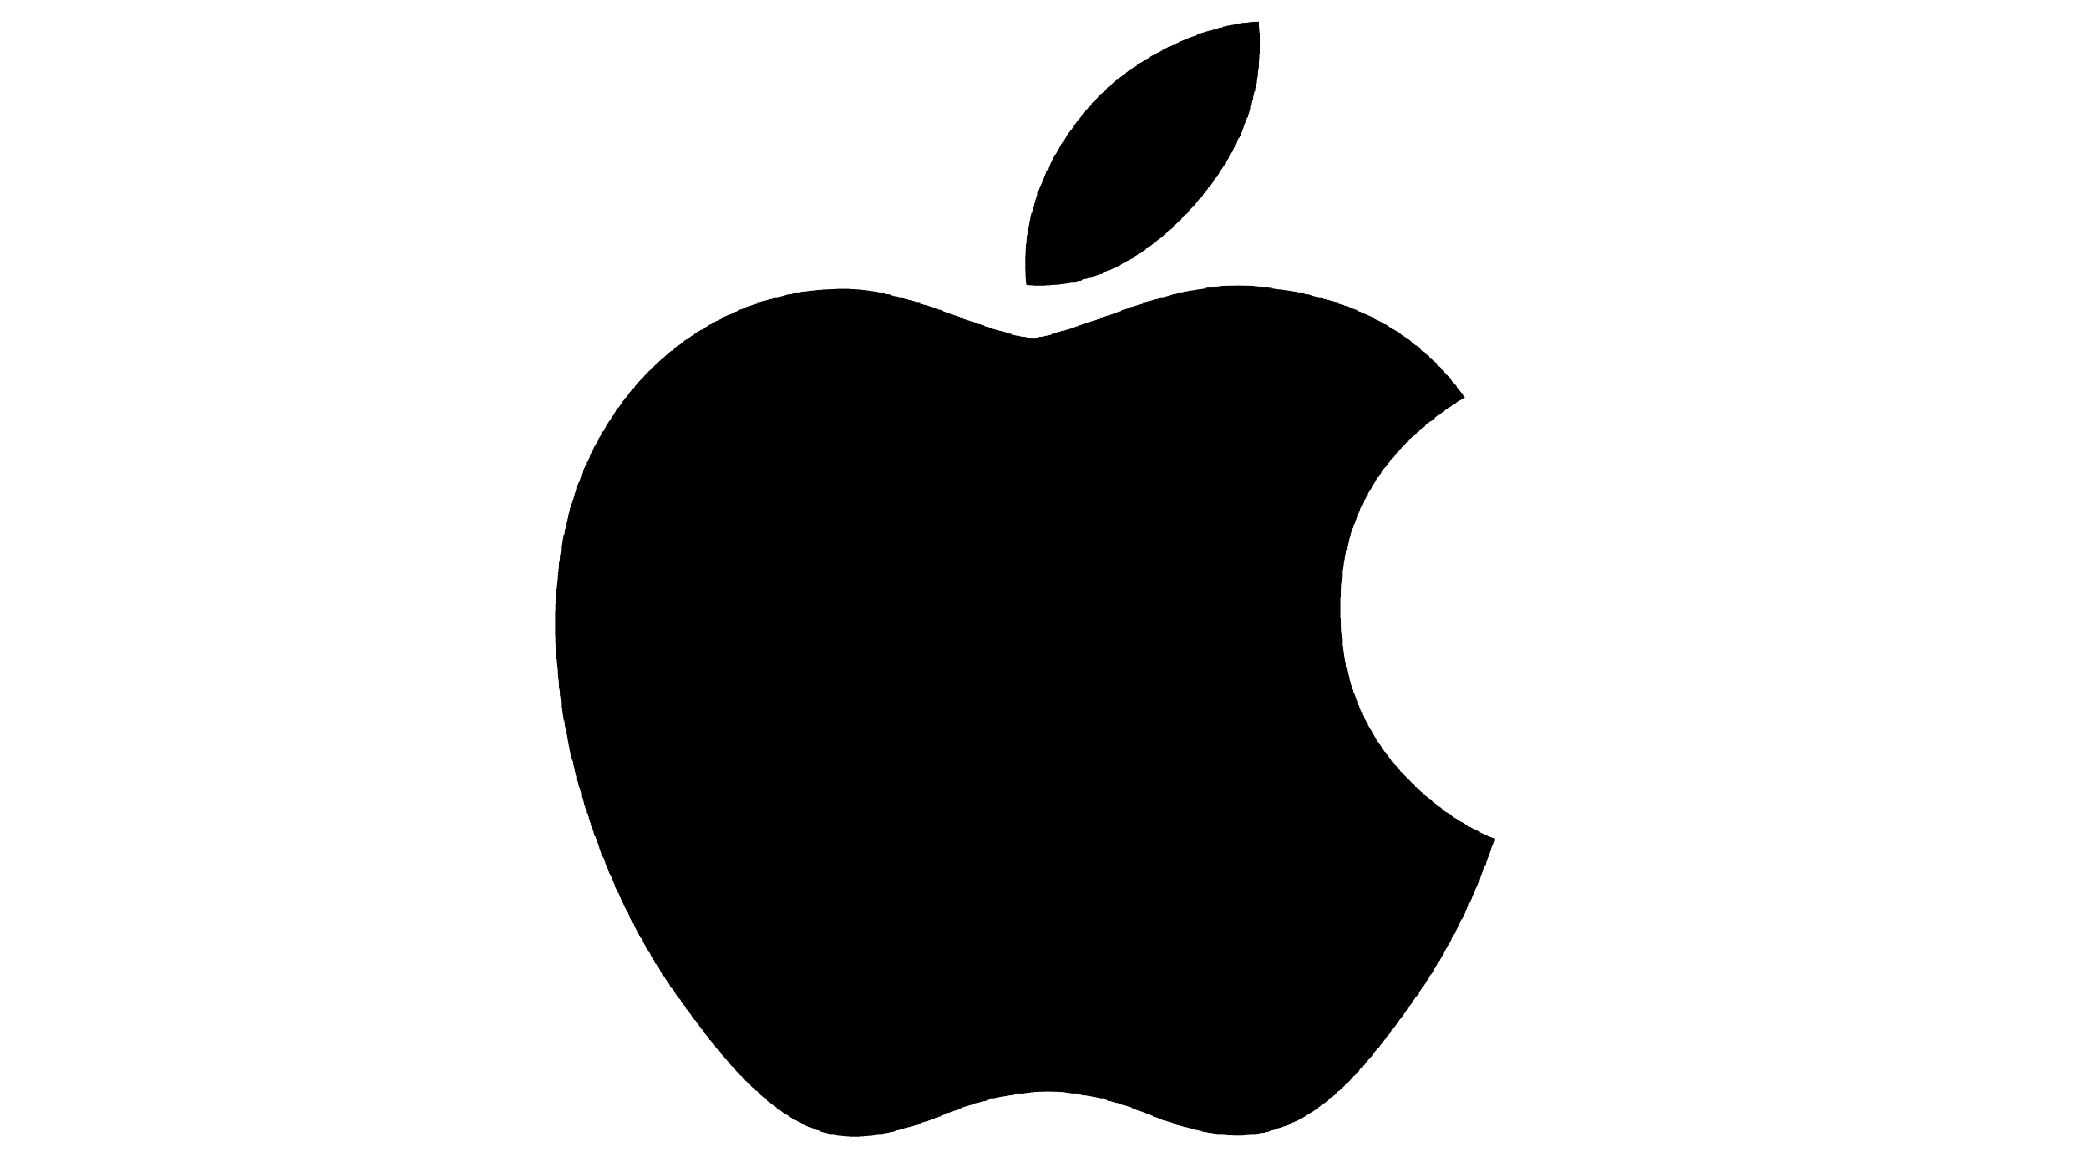
Is Apple still worth investing in? 🍏📊”
“10 years of R&D, revenue & performance trends (2015–2024)”

Slide 2
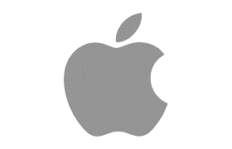
“📊 The Dataset” (2015–2024)
🔬 R&D Expenditure
💰 Revenue (in $ millions)
📈 ROA, ROE, ROI (in percentage)
📉 EPS (in thousand $)

Slide 3
✅ Key Findings
R&D grew from $8B in 2015 → $31B in 2024
Revenue peaked at $394B (2022)
Correlations with R&D:
📈 Revenue: 0.95
📊 ROA: 0.86
📊 ROE: 0.92
📊 ROI: 0.93
❌ EPS volatile (-0.56 correlation)

Slide 4
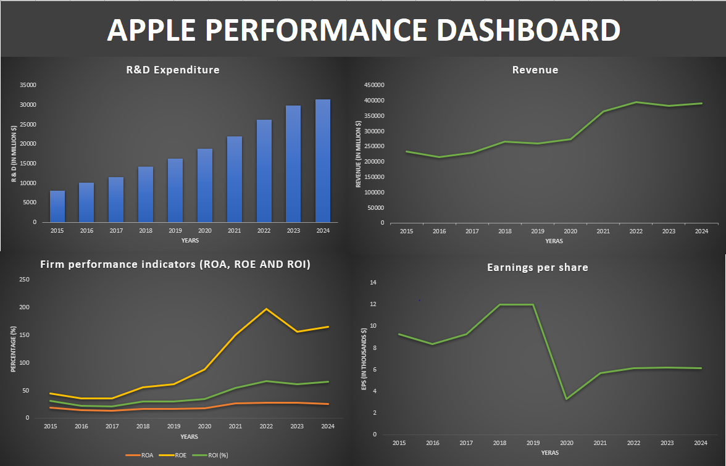
💡 What This Means
R&D is Apple’s engine of growth 🚀
Higher R&D → stronger profitability (ROA, ROE, ROI)
Revenue remains resilient despite global challenges
EPS noise ≠ weakness — fundamentals are solid

Slide 5
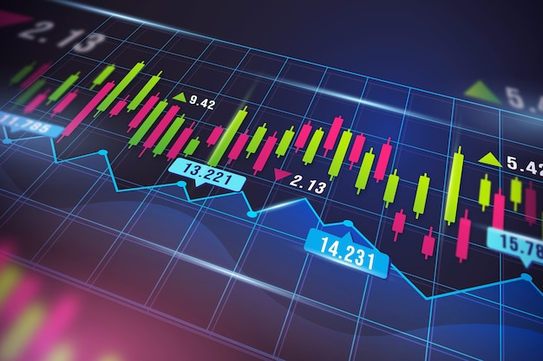
Investment Outlook
Apple is a buy-and-hold stock ✅
Long-term growth supported by R&D
Shareholder value likely to remain strong
See full analysis & dashboard on GitHub: [https://github.com/Tayoowonikoko/Excel-Data-analysis-project]

